Slide 1
Language Models
Hongning Wang
CS@UVa

Slide 2
Notion of Relevance
Relevance
Δ(Rep(q), Rep(d))
Similarity
P(r=1|q,d) r ∈{0,1}
Probability of Relevance
P(d →q) or P(q →d)
Probabilistic inference
Regression
Model
(Fox 83)
Generative Model
Different
inference system
Different
rep & similarity
Doc
generation
Query
generation
…
Prob. concept
space model
(Wong & Yao, 95)
Inference
network
model
(Turtle & Croft, 91)
Vector space
model
(Salton et al., 75)
Prob. distr.
model
(Wong & Yao, 89)
Classical
prob. Model
(Robertson &
Sparck Jones, 76)
LM approach
(Ponte & Croft, 98)
(Lafferty & Zhai, 01a)

Slide 3
Query generation models
Query likelihood p(q| θ_{d})
Document prior
Assuming uniform document prior, we have
Now, the question is how to compute ?
Generally involves two steps:
(1) estimate a language model based on D
(2) compute the query likelihood according to the estimated model
Language models, we will cover it now!

Slide 4
What is a statistical LM?
A model specifying a probability distribution over word sequences
p(“Today is Wednesday”) ≈ 0.001
p(“Today Wednesday is”) ≈ 0.0000000000001
p(“The eigenvalue is positive”) ≈ 0.00001
It can be regarded as a probabilistic mechanism for “generating” text, thus also called a “generative” model

Slide 5
Why is a LM useful?
Provides a principled way to quantify the uncertainties associated with natural language
Allows us to answer questions like:
Given that we see “John” and “feels”, how likely will we see “happy” as opposed to “habit” as the next word?
(speech recognition)
Given that we observe “baseball” three times and “game” once in a news article, how likely is it about “sports”?
(text categorization, information retrieval)
Given that a user is interested in sports news, how likely would the user use “baseball” in a query?
(information retrieval)

Slide 6
Source-Channel framework ^{[Shannon 48]}
Source
Transmitter
(encoder)
Noisy
Channel
Receiver
(decoder)
Destination
X
Y
X’
P(X)
P(X|Y)=?
P(Y|X)
(Bayes Rule)
When X is text, p(X) is a language model
Many Examples:
Speech recognition: X=Word sequence Y=Speech signal
Machine translation: X=English sentence Y=Chinese sentence
OCR Error Correction: X=Correct word Y= Erroneous word
Information Retrieval: X=Document Y=Query
Summarization: X=Summary Y=Document

Slide 7

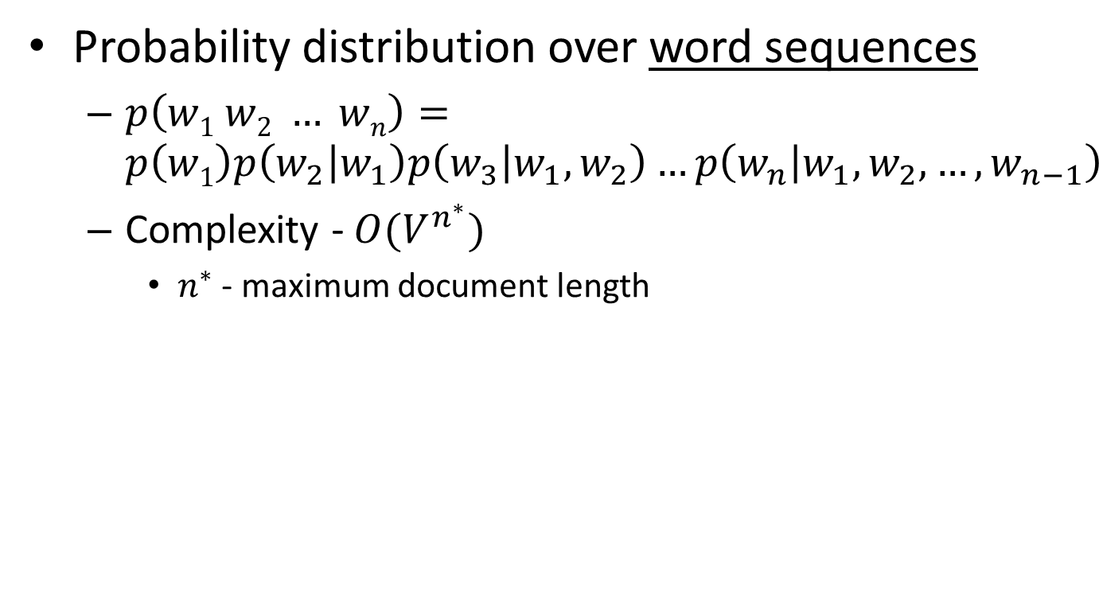

Language model for text
We need independence assumptions!
Probability distribution over word sequences
$p\left(w1 w2 … wn\right)=p\left(w1\right)p\left(w_{2} | w_{1}\right)p\left(w_{3} | w_{1},w_{2}\right)…p\left(w_{n} | w_{1},w_{2},…,w_{n−1}\right)$
Complexity - $O(V^{n^{∗}})$
$n^{∗}$ - maximum document length
sentence
Chain rule: from conditional probability to joint probability
475,000 main headwords in Webster's Third New International Dictionary
Average English sentence length is 14.3 words
A rough estimate: $O({475000}^{14})$
$$\frac{{475000}^{14}}{8bytes×{\left(1024\right)}^{4}}≈3.38e^{66}TB$$
How large is this?

Slide 8
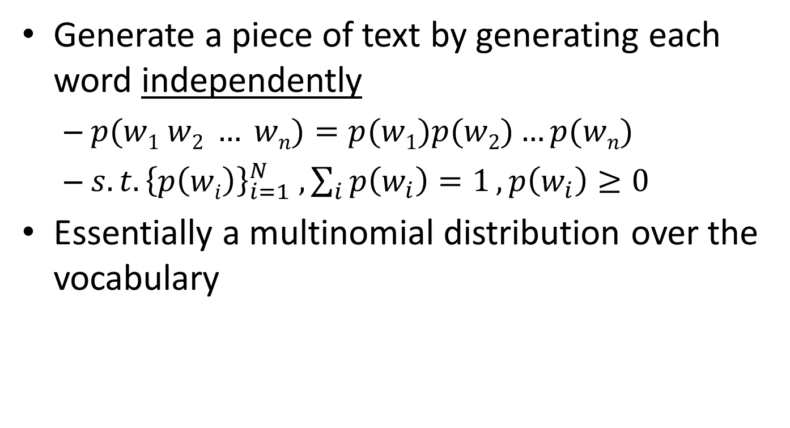
Unigram language model
Generate a piece of text by generating each word independently
$p(w1 w2 … wn)=p(w1)p(w2)…p(wn)$
${s.t. \left\{p\left(wi\right)\right\}}_{i=1}^{N} , \sum_{i}{p\left(w_{i}\right)=1}, p\left(w_{i}\right)≥0$
Essentially a multinomial distribution over the vocabulary
The simplest and most popular choice!

Slide 9
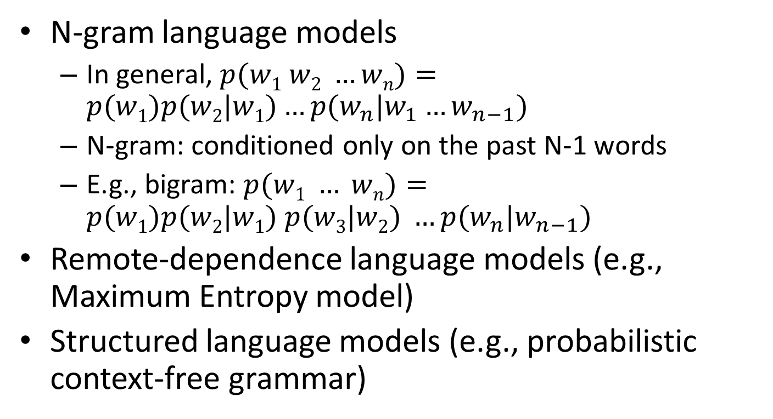
More sophisticated LMs
N-gram language models
In general, $p(w1 w2 …wn)=p(w1)p(w2|w1)…p(w_{n}|w_{1}…w_{n−1})$
N-gram: conditioned only on the past N-1 words
E.g., bigram: $p(w1 … wn)=p(w1)p(w2|w1) p(w3|w2) …p(w_{n}|w_{n−1})$
Remote-dependence language models (e.g., Maximum Entropy model)
Structured language models (e.g., probabilistic context-free grammar)

Slide 10
Why just unigram models?
Difficulty in moving toward more complex models
They involve more parameters, so need more data to estimate
They increase the computational complexity significantly, both in time and space
Capturing word order or structure may not add so much value for “topical inference”
But, using more sophisticated models can still be expected to improve performance ...

Slide 11
Language models for IR ^{[Ponte & Croft SIGIR’98]}
Document
Language Model
Query
…
text ?
mining ?
assocation ?
clustering ?
…
food ?
…
Text mining
paper
?
“data mining algorithms”
…
food ?
nutrition ?
healthy ?
diet ?
…
Food nutrition
paper
Which model would most
likely have generated this query?

Slide 12
Ranking docs by query likelihood
Doc LM
Query likelihood
d₁
θ_{d1}
p(q| θ_{d1})
q
d₂
θ_{d2}
p(q| θ_{d2})
……
……
p(q| θ_{dN})
d_{N}
θ_{dN}
Justification: PRP

Slide 13
Retrieval as language model estimation
Document ranking based on query likelihood
Retrieval problem ≈ Estimation of $p(wi|d)$
Common approach
Maximum likelihood estimation (MLE)
Document language model

Slide 14
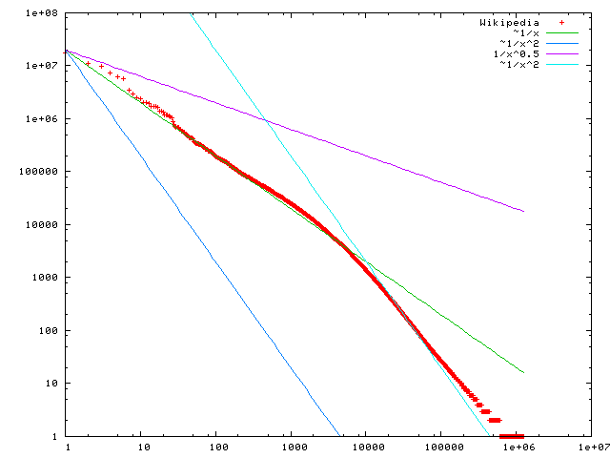

Problem with MLE
Unseen events
There are 440K tokens on a large collection of Yelp reviews, but:
Only 30,000 unique words occurred
Only 0.04% of all possible bigrams occurred
This means any word/N-gram that does not occur in the collection has a zero probability with MLE!
No future queries/documents can contain those unseen words/N-grams
$$f\left(k;s,N\right)∝1/k^{s}$$
Word frequency
Word rank by frequency
A plot of word frequency in Wikipedia (Nov 27, 2006)

Slide 15
Problem with MLE
What probability should we give a word that has not been observed in the document?
log0?
If we want to assign non-zero probabilities to such words, we’ll have to discount the probabilities of observed words
This is so-called “smoothing”

Slide 16
Illustration of language model smoothing
P(w|d)
Max. Likelihood Estimate
Smoothed LM
w
Discount from the seen words
Assigning nonzero probabilities to the unseen words

Slide 17
General idea of smoothing
All smoothing methods try to
Discount the probability of words seen in a document
Re-allocate the extra counts such that unseen words will have a non-zero count

Slide 18
Smoothing methods
Method 1: Additive smoothing
Add a constant δ to the counts of each word
Problems?
Hint: all words are equally important?
Counts of w in d
“Add one”, Laplace smoothing
Vocabulary size
Length of d (total counts)

Slide 19
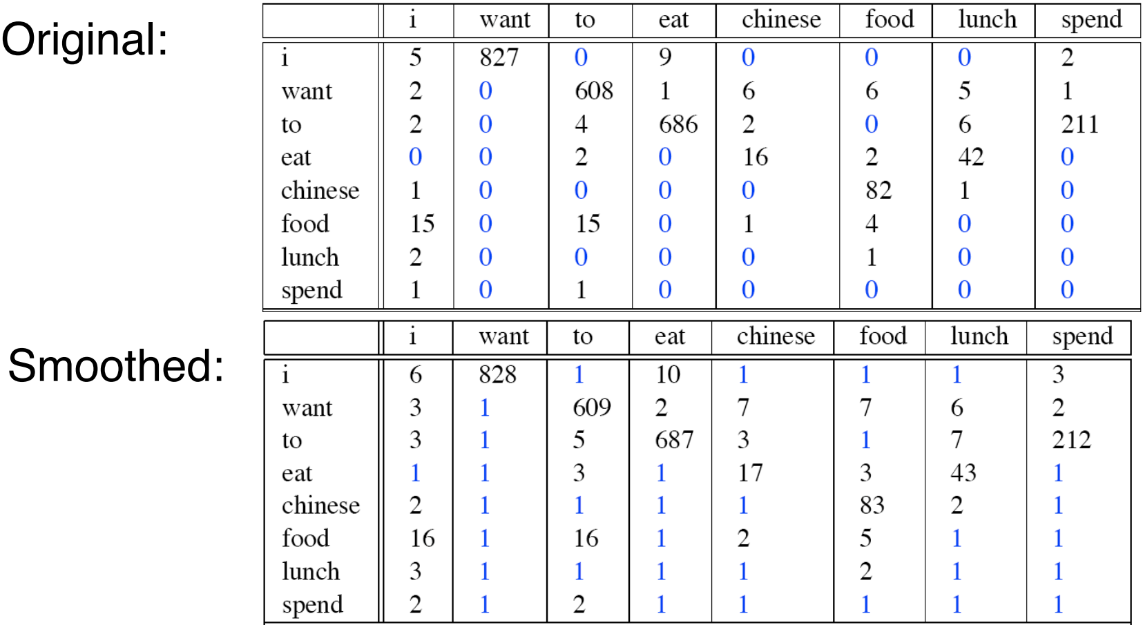
Add one smoothing for bigrams

Slide 20
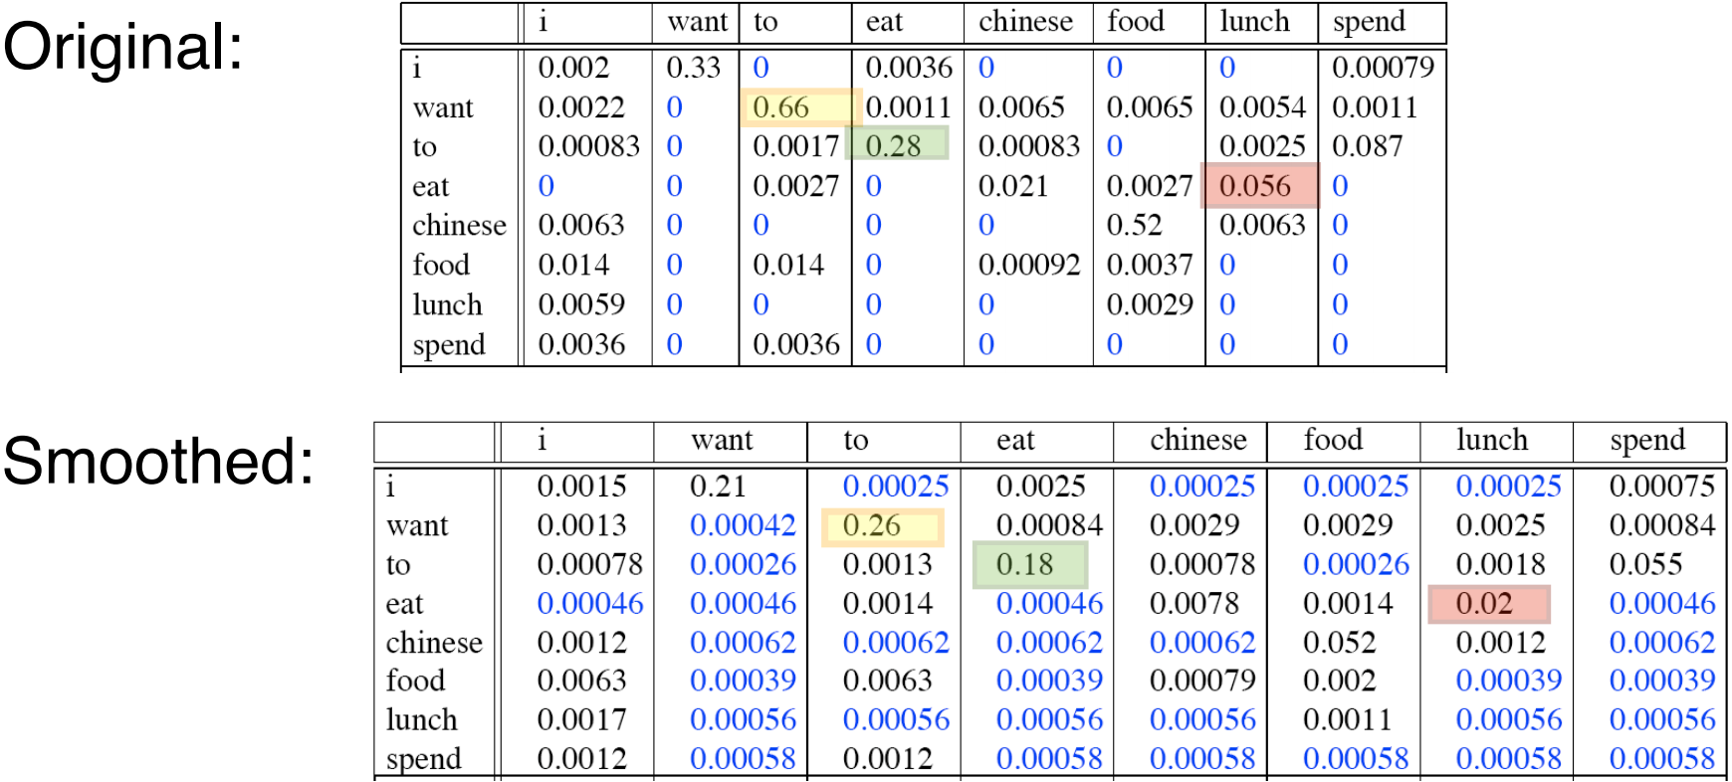
After smoothing
Giving too much to the unseen events without discrimination

Slide 21
Refine the idea of smoothing
Should all unseen words get equal probabilities?
We can use a reference model to discriminate unseen words
Discounted ML estimate
Reference language model

Slide 22
Smoothing methods
Method 2: Absolute discounting
Subtract a constant δ from the counts of each word
Problems?
Hint: varied document length?
# uniq words

Slide 23
Smoothing methods
Method 3: Linear interpolation, Jelinek-Mercer
“Shrink” uniformly toward p(w|REF)
Problems?
Hint: what is missing?
parameter
MLE

Slide 24
Smoothing methods
Method 4: Dirichlet Prior/Bayesian
Assume pseudo counts μp(w|REF)
Problems?
parameter

Slide 25
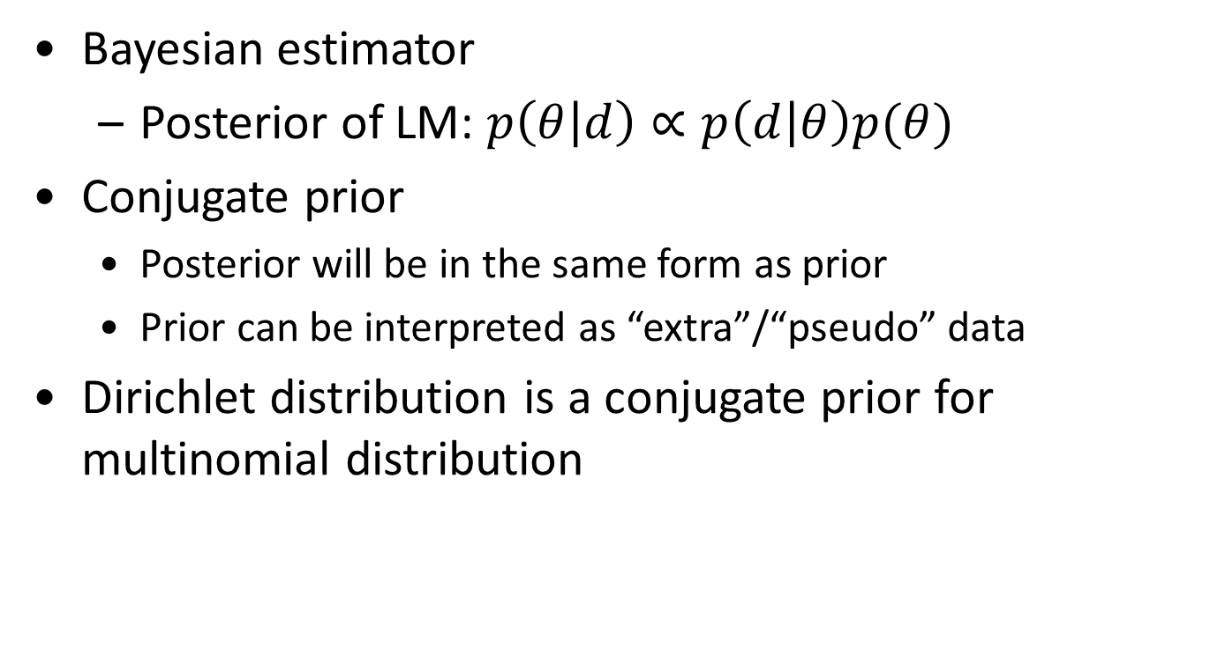
Dirichlet prior smoothing
likelihood of doc given the model
Bayesian estimator
Posterior of LM: $p\left(θ | d\right)∝p\left(d | θ\right)p(θ)$
Conjugate prior
Posterior will be in the same form as prior
Prior can be interpreted as “extra”/“pseudo” data
Dirichlet distribution is a conjugate prior for multinomial distribution
prior over models
“extra”/“pseudo” word counts, we set α_{i}=μ p(w_{i}|REF)

Slide 26
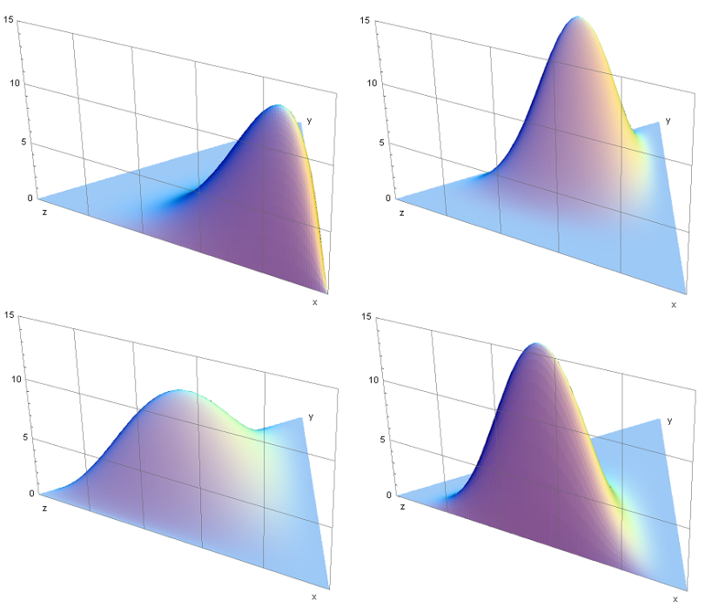
Some background knowledge
Conjugate prior
Posterior dist in the same family as prior
Dirichlet distribution
Continuous
Samples from it will be the parameters in a multinomial distribution
Gaussian -> Gaussian
Beta -> Binomial
Dirichlet -> Multinomial

Slide 27
Dirichlet prior smoothing (cont)
Posterior distribution of parameters:
The predictive distribution is the same as the mean:
Dirichlet prior smoothing

Slide 28
Estimating μ using leave-one-out ^{[Zhai & Lafferty 02]}
w₁
Leave-one-out
P(w₁|d_{- w1})
log-likelihood
w₂
P(w₂|d_{- w2})
Maximum Likelihood Estimator
...
w_{n}
P(w_{n}|d_{- wn})

Slide 29
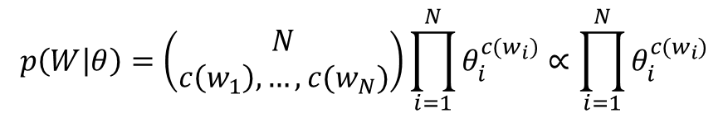


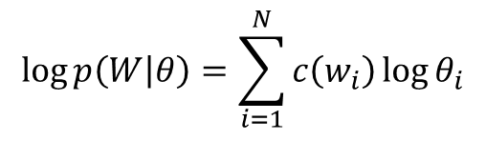
Understanding smoothing
Topical words
Query = “the algorithms for data mining”
p_{ML}(w|d1): 0.04 0.001 0.02 0.002 0.003
p_{ML}(w|d2): 0.02 0.001 0.01 0.003 0.004
$$4.8×{10}^{−12}$$
$$2.4×{10}^{−12}$$
p( “algorithms”|d1) = p(“algorithms”|d2)
p( “data”|d1) < p(“data”|d2)
p( “mining”|d1) < p(“mining”|d2)
Intuitively, d2 should have a higher score,
but p(q|d1)>p(q|d2)…
So we should make p(“the”) and p(“for”) less different for all docs,
and smoothing helps to achieve this goal…
$$2.35×{10}^{−13}$$
$$4.53×{10}^{−13}$$
Query = “the algorithms for data mining”
P(w|REF) 0.2 0.00001 0.2 0.00001 0.00001
Smoothed p(w|d1): 0.184 0.000109 0.182 0.000209 0.000309
Smoothed p(w|d2): 0.182 0.000109 0.181 0.000309 0.000409

Slide 30
Two-stage smoothing ^{[Zhai & Lafferty 02]}
Stage-1
-Explain unseen words
-Dirichlet prior (Bayesian)
Stage-2
-Explain noise in query
-2-component mixture
μ
λ
Collection LM
c(w,d)
+μp(w|C)
P(w|d) =
(1-λ)
+ λp(w|U)
|d|
+μ
User background model

Slide 31

Smoothing & TF-IDF weighting
Smoothed ML estimate
Retrieval formula using the general smoothing scheme
Reference language model
$$c\left(w,q\right)>0$$
Key rewriting step (where did we see it before?)
Similar rewritings are very common when using probabilistic models for IR…

Slide 32
Understanding smoothing
Plug in the general smoothing scheme to the query likelihood retrieval formula, we obtain
Doc length normalization
(longer doc is expected to have a smaller α_{d})
TF weighting
IDF weighting
Ignore for ranking
Smoothing with p(w|C) ≈ TF-IDF + doc-length normalization

Slide 33
What you should know
How to estimate a language model
General idea and different ways of smoothing
Effect of smoothing

Slide 34
Today’s reading
Introduction to information retrieval
Chapter 12: Language models for information retrieval

